Slide 1

Intro to Web Design Using Bootstrap
REACH High - Spring 2016

Slide 2
Lesson 4: Bootstrap Grid system

Slide 3
Bootstrap Grid system
Used to create page layouts through a series of rows and columns that house your content.
Bootstrap Grid is broken into 12 even columns
For example, If you want your page to have two columns of content, you define each column to span multiple Bootstrap columns:
6 and 6
4 and 8
3 and 9
2 and 10
Etc.

Slide 4
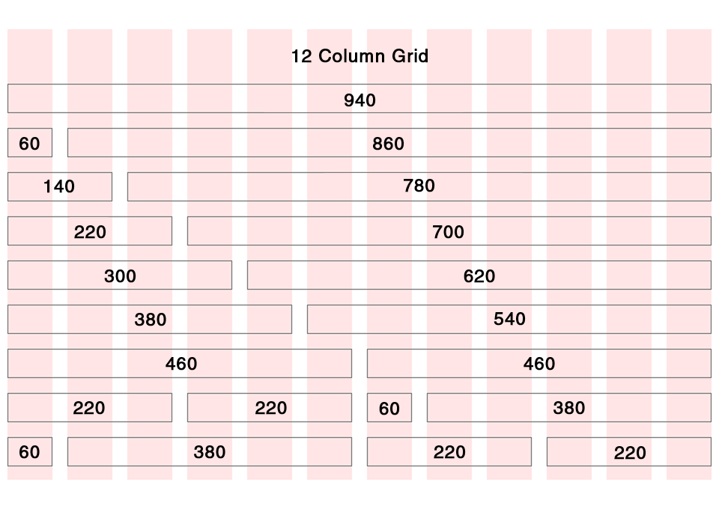

Slide 5
Bootstrap Grid System
<div class="container">
<div class="row">
<div class="col-md-6“>Column1</div>
<div class="col-md-6“>Column2</div>
</div>
</div>

Slide 6
Grid system is responsive
Side-by-side content will stack on top of each other when the screen gets too narrow
https://getbootstrap.com/examples/grid/

Slide 7
Choose when the CONTENT IS SIDE-BY-SIDE
lg - Only at LARGE screen widths (large Desktops) and above (>1200 px)
md – Only at MEDIUM screen widths (Desktops) and above (>992 px)
sm – Only at SMALL screen widths (Tablets) and above (>768 px)
xs – At EXTRA SMALL screen widths (Phones) and above

Slide 8
Examples of classes
col-md-6
col-xs-8
col-sm-2

Slide 9
Other Grid System options
Can nest grids within each other
Within a row, classes can add up to more than 12 columns
It will just wrap after 12
When different <div>s have different heights, the wrapping can get messed up. Use <div class="clearfix"></div> to fix

Slide 10
More Bootstrap Helper Classes
Classes that hide content at certain sizes:
hidden-xs hidden-sm hidden-md hidden-lg
Class that hides content when printed
hidden-print

Slide 11
Using Font Awesome Glyphicons
https://fortawesome.github.io/Font-Awesome/
Find and Copy the HTML

Slide 12
Exercise 4

